Slide 1





RED PAND-AI
Empowering patients to understand their medical information

Slide 2

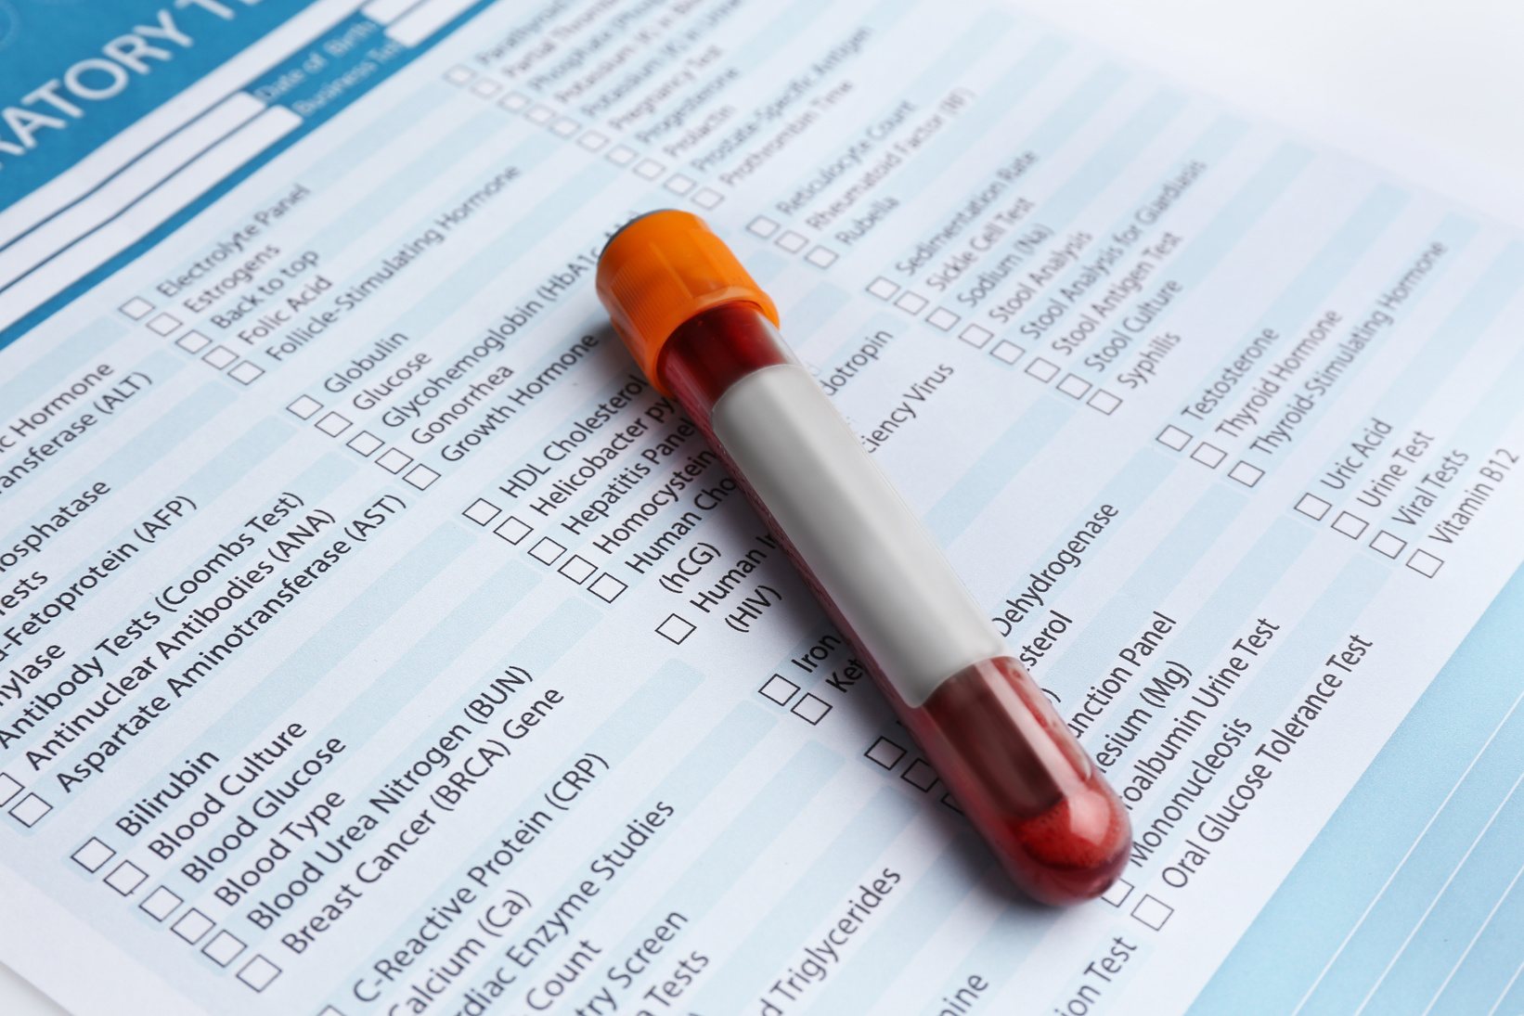
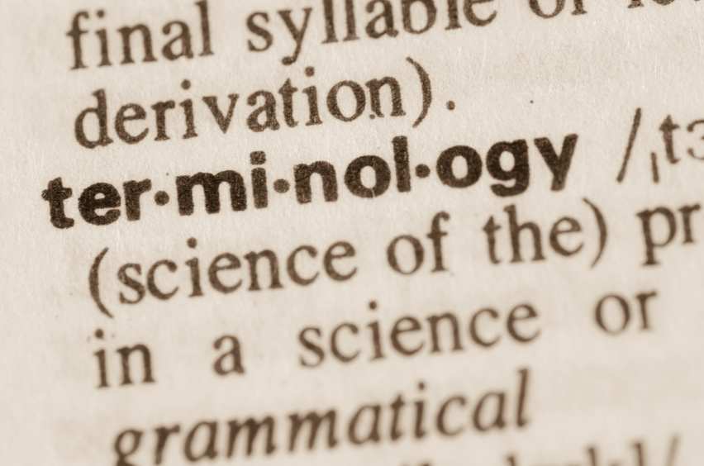




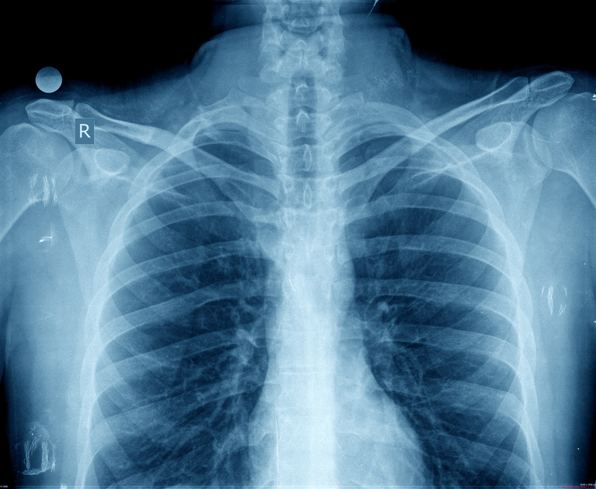
RED PAND-AI
Problem
2 in 3 patients are left overwhelmed by fragmented health information

Slide 3
RED PAND-AI
Problem
2 in 3 patients are left overwhelmed by fragmented health information
Most patients rely on memory or paper notes to piece together their care journey

Slide 4


RED PAND-AI
Meet Michael

Slide 5
RED PAND-AI
Meet Michael
Michael has just received a call from his GP after a restless night with sharp left-sided chest pain

Slide 6
RED PAND-AI
Meet Michael
Michael has just received a call from his GP after a restless night with sharp left-sided chest pain
The doctor suspects cardiac, pulmonary, or musculoskeletal causes for the chest pain and has ordered an ECG, chest X-ray, and blood tests

Slide 7

RED PAND-AI
What am I supposed to do?

Slide 8
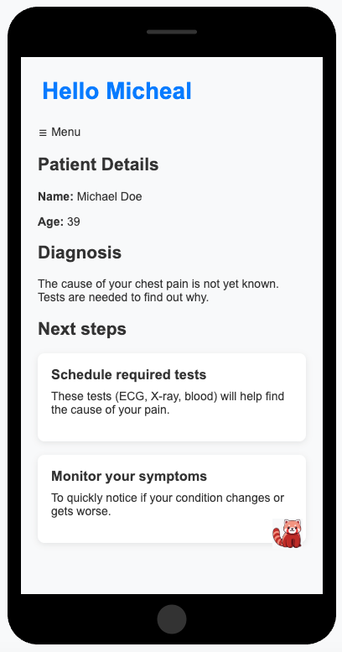
RED PAND-AI
RAI Health
Integrated platform giving users a complete picture into their
Digestible health information, in layperson language
Chatbot to allow users to ask questions and schedule appointments in their calendar

Slide 9
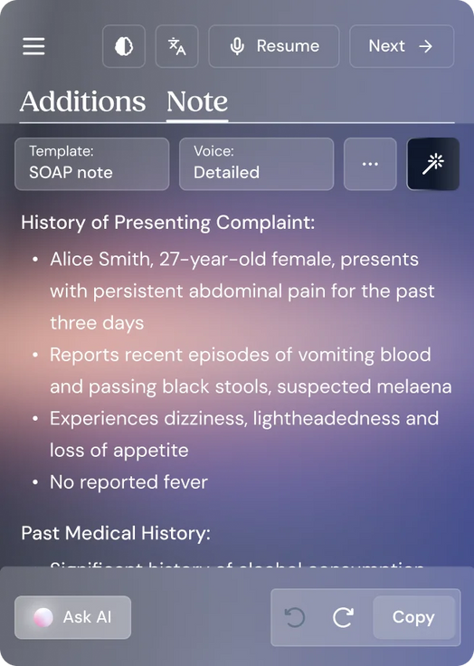

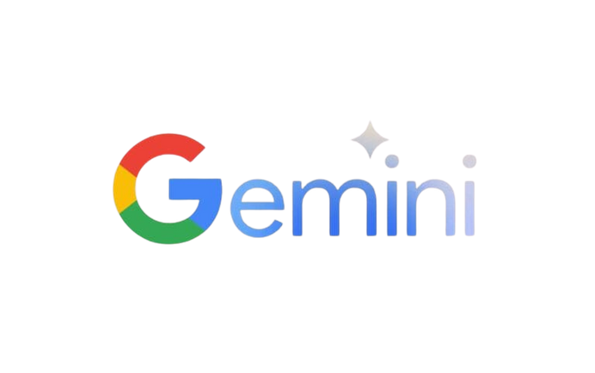
RED PAND-AI
Technical Workflow
Consultation notes transcribed from Heidi API are intepreted by Google Gemini and fed into the RAI Health app

Slide 10
RED PAND-AI
User Interface

Slide 11
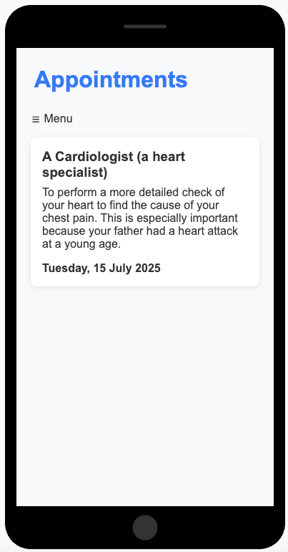
RED PAND-AI
User Interface

Slide 12
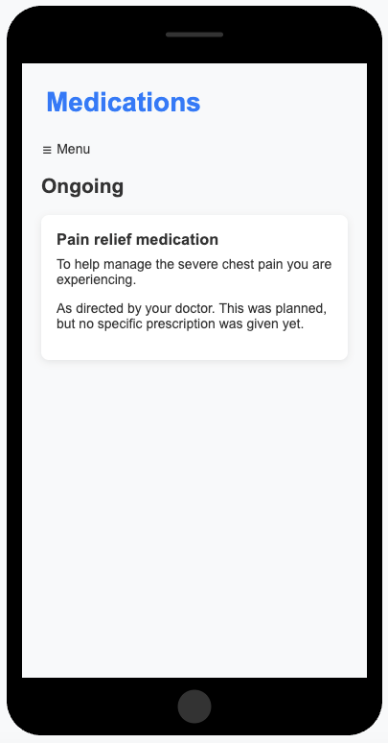
RED PAND-AI
User Interface

Slide 13
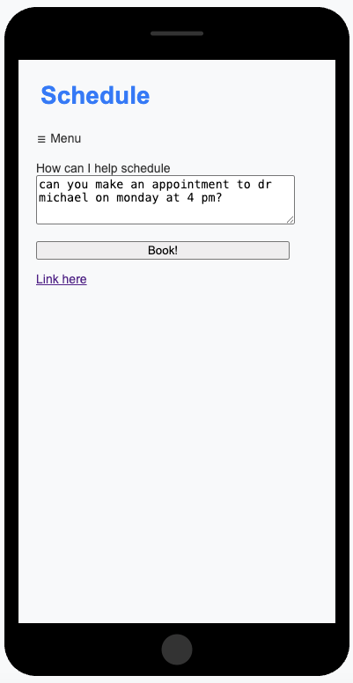
RED PAND-AI
User Interface

Slide 14
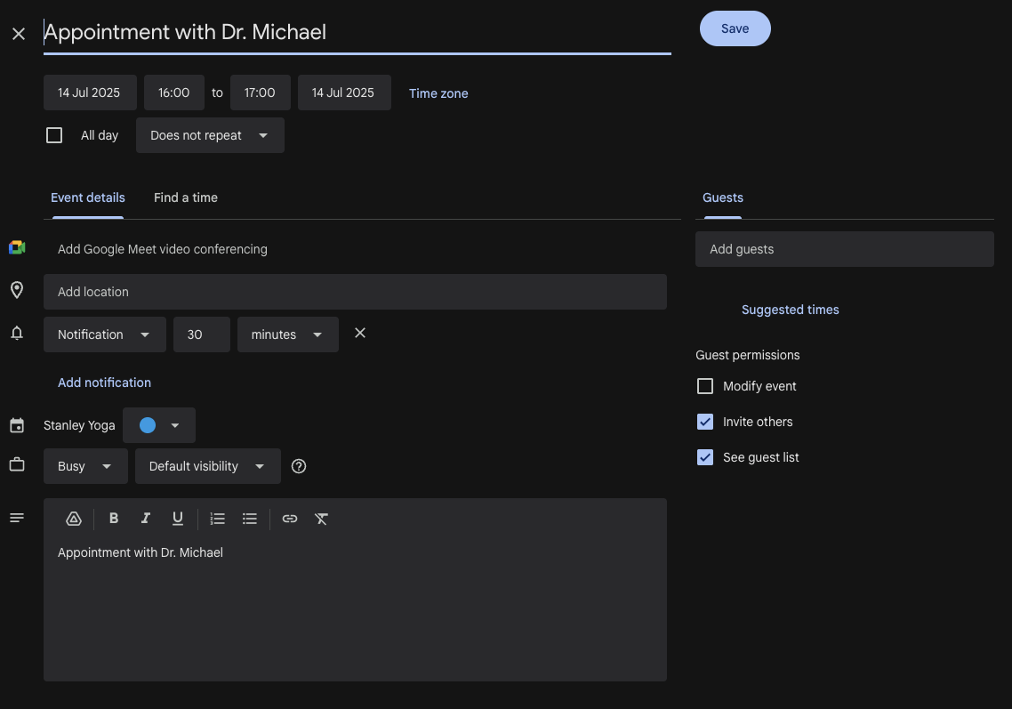
RED PAND-AI
User Interface
Integration with Google Calendar to streamline appointment notifications and reminders

Slide 15

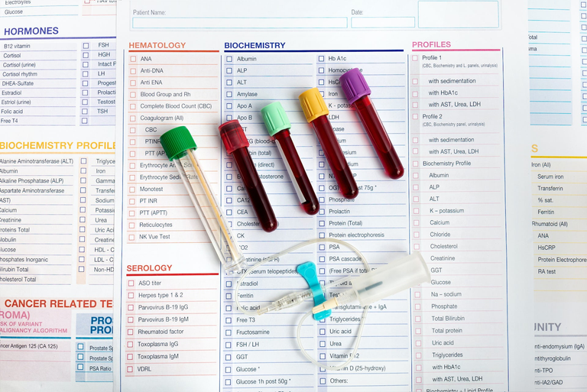
RED PAND-AI
Next Steps
Addition of premium features to generate revenue for the company - subscription model
Telehealth services tailored to the needs of the individual.
Permissions to upload images of test results, with Gemini providing a high level summary

Slide 16
Demo + QnA

Slide 17
RED PAND-AI
Demo & Questions

